Slide 1
Deadlock
Course Instructor: Nausheen Shoaib

Slide 2
Deadlock
A set of processes is deadlocked when each process in the set is blocked awaiting an event that can only be triggered by another blocked process in the set
Typically involves processes competing for the same set of resources
No efficient solution
Notes:
A set of processes is deadlocked when each process in the set is blocked awaiting an event that can only be triggered by another blocked process in the set
typically processes are waiting the freeing up of some requested resource.
Deadlock is permanent because none of the events is ever triggered.
Unlike other problems in concurrent process management, there is no efficient solution in the general case.

Slide 3

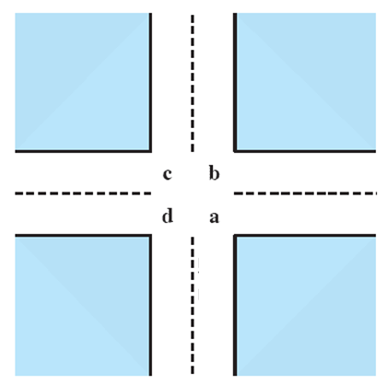
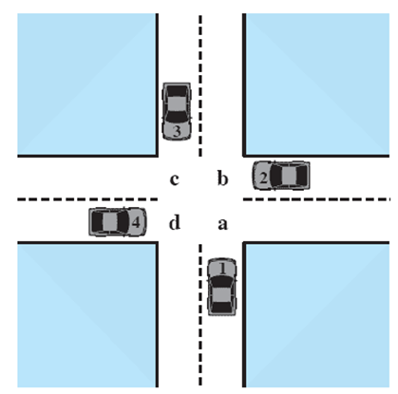



Potential Deadlock
I need quad C and B
I need quad B and C
I need quad A and B
I need quad D and A
Notes:
Animated Slide
Click 1 Cars approach intersection
Then Cars announce their resource needs
All deadlocks involve conflicting needs for resources by two or more processes. A common example is the traffic deadlock.
The typical rule of the road in the United States is that a car at a four-way stop should defer to a car immediately to its right.
This rule works if there are only two or three cars at the intersection.
If all four cars arrive at about the same time, each will refrain from entering the intersection, this causes a potential deadlock.
The deadlock is only potential, not actual, because the necessary resources are available for any of the cars to proceed.
If one car eventually does proceed, it can do so.

Slide 4
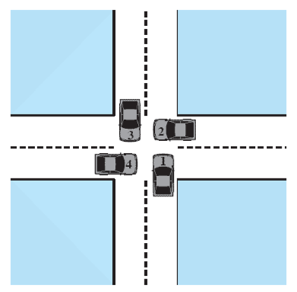
Actual Deadlock
HALT until D is free
HALT until C is free
HALT until B is free
HALT until A is free
Notes:
Animated Slide
Click 1 Cars move to deadlock
Then Cars announce their resource need
But if all four cars ignore the rules and proceed (cautiously) into the intersection at the same time, then each car seizes one resource (one quadrant) but cannot proceed because the required second resource has already been seized by another car.
This is an actual deadlock.

Slide 5
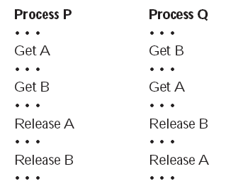
Two Processes P and Q
Lets look at this with two processes P and Q
Each needing exclusive access to a resource A and B for a period of time
Notes:
Each process needs exclusive use of both resources for a certain period of time.
Two processes, P and Q, have the following general form:

Slide 6
Resource Categories
Two general categories of resources:
Reusable
can be safely used by only one process at a time and is not depleted by that use.
Consumable
one that can be created (produced) and destroyed (consumed).

Slide 7
Reusable Resources
Such as:
Processors, I/O channels, main and secondary memory, devices, and data structures such as files, databases, and semaphores
Deadlock occurs if each process holds one resource and requests the other

Slide 8
Consumable Resources
Such as Interrupts, signals, messages, and information in I/O buffers
Deadlock may occur if a Receive message is blocking
May take a rare combination of events to cause deadlock

Slide 9
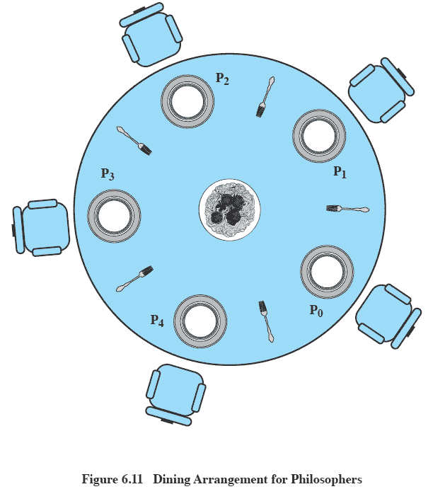
Dining Philosophers Problem: Scenario
Notes:
Five philosophers live in a house, where a table is laid for them.
The life of each philosopher consists principally of thinking and eating, and through years of thought, all of the philosophers had agreed that the only food that contributed to their thinking efforts was spaghetti.
Due to a lack of manual skill, each philosopher requires two forks to eat spaghetti.
A philosopher wishing to eat goes to his or her assigned place at the table and, using the two forks on either side of the plate, takes and eats some spaghetti.

Slide 10
The Problem
Devise a ritual (algorithm) that will allow the philosophers to eat.
No two philosophers can use the same fork at the same time (mutual exclusion)
No philosopher must starve to death (avoid deadlock and starvation … literally!)

Slide 11
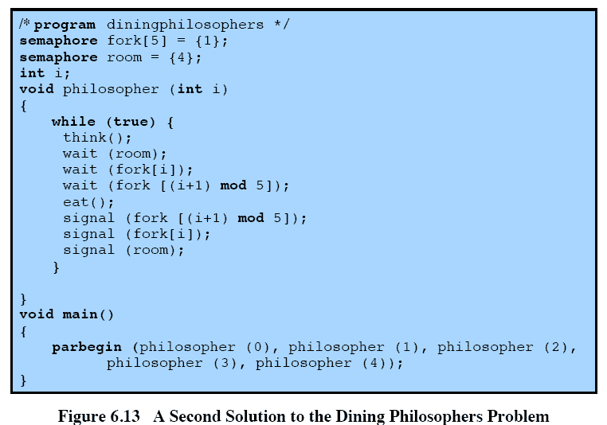
Avoiding deadlock
Notes:
We could consider adding an attendant who only allows four philosophers at a time into the dining room.
With at most four seated philosophers, at least one philosopher will have access to two forks.
This slide shows such a solution, again using semaphores. This solution is free of deadlock and starvation.

Slide 12
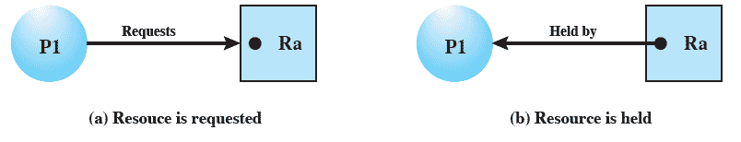
Resource Allocation Graphs
Directed graph that depicts a state of the system of resources and processes
Notes:
A graph edge directed from a process to a resource indicates a resource that has been requested by the process but not yet granted.
Within a resource node, a dot is shown for each instance of that resource.
A graph edge directed from a reusable resource node dot to a process indicates a request that has been granted

Slide 13
Conditions for possible Deadlock
Mutual exclusion (non-sharable resources)
Only one process may use a resource at a time
Hold-and-wait
A process may hold allocated resources while awaiting assignment of others
No pre-emption
No resource can be forcibly removed from a process holding it
Notes:
All three must be present for deadlock to occur.

Slide 14
Actual Deadlock Requires …
All previous 3 conditions plus:
Circular wait
A closed chain of processes exists, such that each process holds at least one resource needed by the next process in the chain
Notes:
This is actually a potential consequence of the first three.
Given that the first three conditions exist, a sequence of events may occur that lead to an unresolvable circular wait.
The unresolvable circular wait is in fact the definition of deadlock.
The circular wait listed as condition 4 is unresolvable because the first three conditions hold.
Thus, the four conditions, taken together, constitute necessary and sufficient conditions for deadlock.

Slide 15
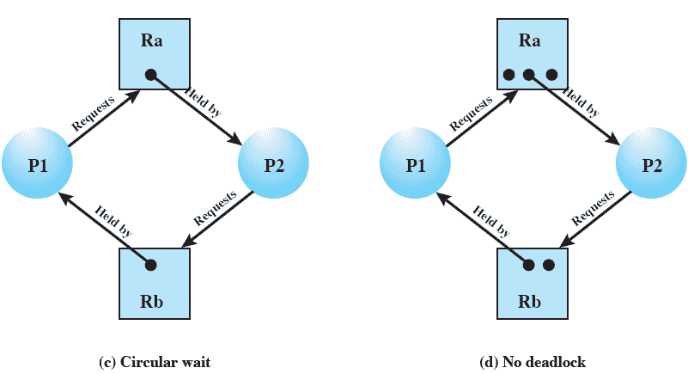
Resource Allocation Graphs of deadlock

Slide 16
Resource Allocation Graphs of deadlock
Deadlocks can be described more precisely in terms of a directed graph called
a system resource-allocation graph

Slide 17
Resource Allocation Graphs of deadlock
Resource instances:
◦ One instance of resource type R1
◦ Two instances of resource type R2
◦ One instance of resource type R3
◦ Three instances of resource type R4
Process states:
◦ Process P1 is holding an instance of resource
type R2 and is waiting for an instance of
resource type R1.
◦ Process P2 is holding an instance of R1 and an
instance of R2 and is waiting for an instance of R3.
◦ Process P3 is holding an instance of R3.

Slide 18
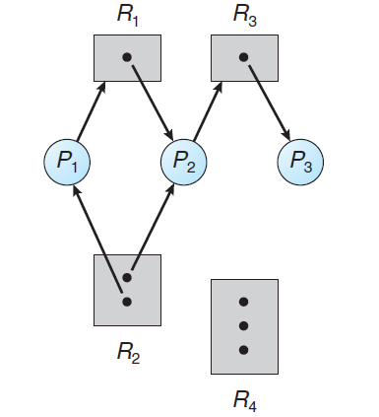
Resource Allocation Graphs of deadlock

Slide 19
Dealing with Deadlock
Three general approaches exist for dealing with deadlock.
Prevent deadlock
Avoid deadlock
Detect Deadlock
Notes:
Three general approaches exist for dealing with deadlock.
prevent deadlock
adopt a policy that eliminates one of the conditions (conditions 1 through 4).
avoid deadlock
by making the appropriate dynamic choices based on the current state of resource allocation.
detect the presence of deadlock
(conditions 1 through 4 hold) and take action to recover.
We discuss each of these approaches in turn.

Slide 20
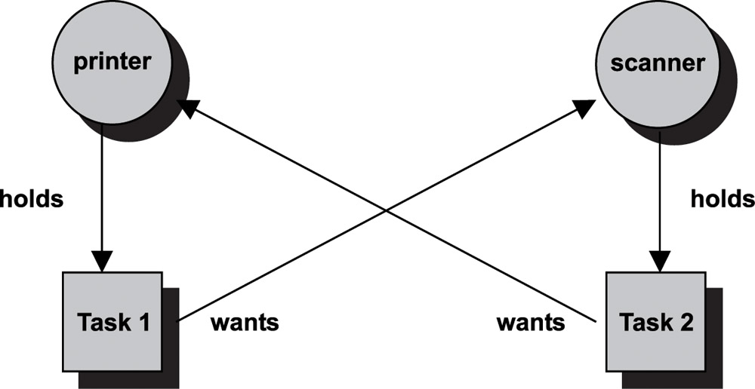
Dealing with Deadlock

Slide 21
Deadlock Prevention Strategy
Design a system in such a way that the possibility of deadlock is excluded.
Two main methods
Indirect – prevent one of the three necessary conditions from occurring
Direct – prevent circular waits
Notes:
Deadlock prevention is strategy simply to design a system in such a way that the possibility of deadlock is excluded.
We can view deadlock prevention methods as falling into two classes.
indirect method of deadlock prevention is to prevent the occurrence of one of the three necessary conditions listed previously (items 1 through 3).
direct method of deadlock prevention is to prevent the occurrence of a circular wait (item 4).
We now examine techniques related to each of the four
conditions.

Slide 22
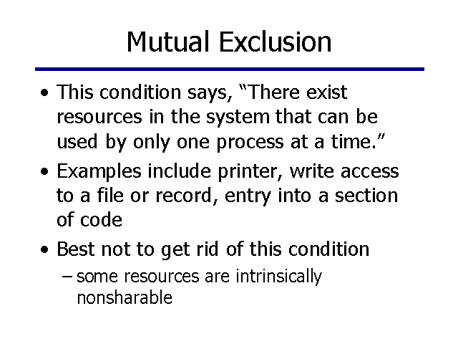
Deadlock Prevention Conditions

Slide 23
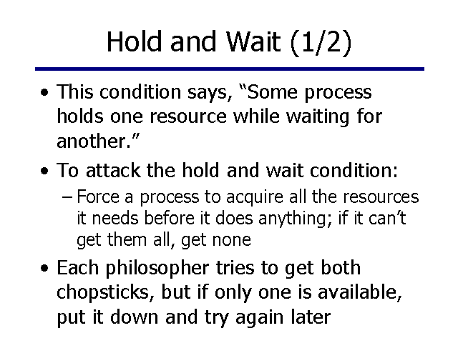
Deadlock Prevention Conditions

Slide 24
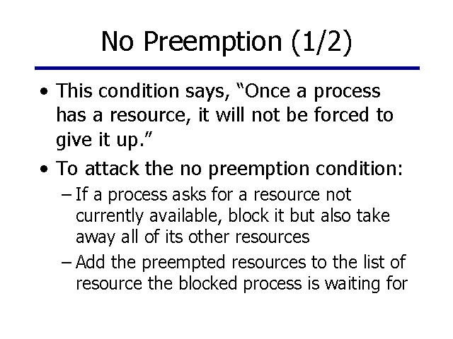
Deadlock Prevention Conditions

Slide 25
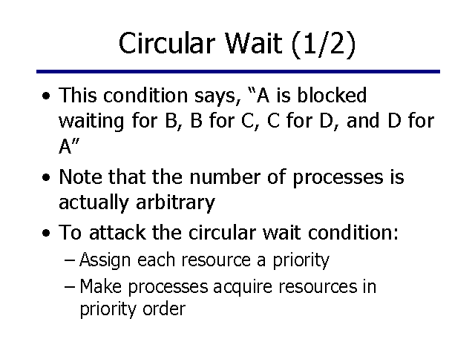
Deadlock Prevention Conditions

Slide 26
Deadlock Avoidance
A decision is made dynamically whether the current resource allocation request will, if granted, potentially lead to a deadlock
Requires knowledge of future process requests
Notes:
Deadlock avoidance allows the three necessary conditions
but makes judicious choices to assure that the deadlock point is never reached.
Avoidance allows more concurrency than prevention.
With deadlock avoidance, a decision is made dynamically whether the current resource allocation request will, if granted, potentially lead to a deadlock.
Deadlock avoidance requires knowledge of future process resource requests.

Slide 27
Two Approaches to Deadlock Avoidance
Process Initiation Denial
Resource Allocation Denial

Slide 28
Process Initiation Denial
A process is only started if the maximum claim of all current processes plus those of the new process can be met.
Not optimal,
Assumes the worst: that all processes will make their maximum claims together.
Notes:
A process is only started if the maximum claim of all current processes plus those of the new process can be met.
This strategy is hardly optimal, because it assumes the worst:
that all processes will make their maximum claims together.

Slide 29
Resource Allocation Denial
Referred to as the banker’s algorithm
A strategy of resource allocation denial
Consider a system with fixed number of resources
State of the system is the current allocation of resources to process
Safe state is where there is at least one sequence that does not result in deadlock
Unsafe state is a state that is not safe
Notes:
Movie button goes to http://gaia.ecs.csus.edu/~zhangd/oscal/Banker/Banker.html

Slide 30
Basic Facts for deadlock avoidance
If a system is in safe state ⇒ no deadlocks
If a system is in unsafe state ⇒ possibility of deadlock
Avoidance ⇒ ensure that a system will never enter an unsafe state.

Slide 31
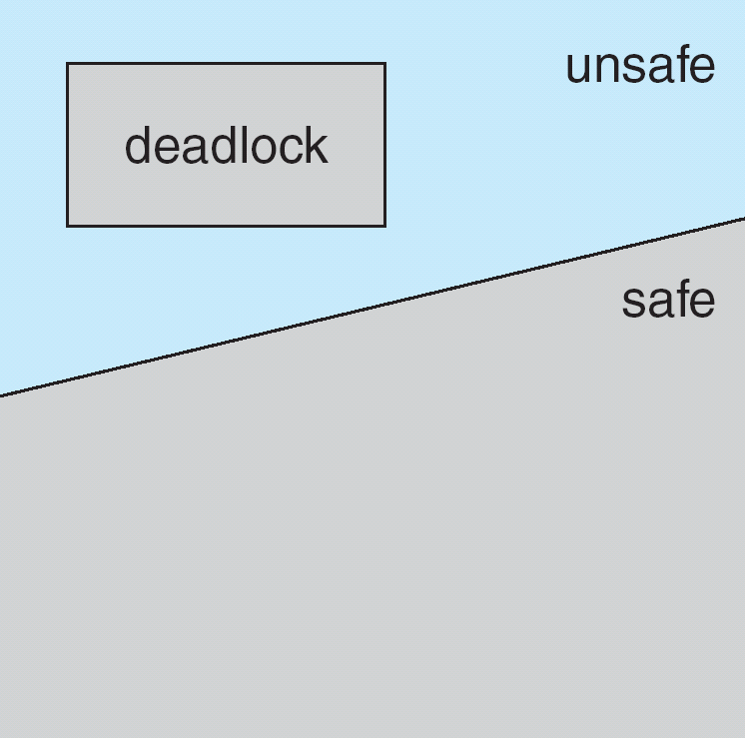
Safe, Unsafe, Deadlock State

Slide 32
Banker’s Algorithm
Multiple instances
Each process must a priori claim maximum use
When a process requests a resource it may have to wait
When a process gets all its resources it must return them in a finite amount of time

Slide 33
Data Structures for the Banker’s Algorithm
Let n = number of processes, and m = number of resources types.
Available: Vector of length m. If available [j] = k, there are k instances of resource type R_{j} available
Max: n x m matrix. If Max [i,j] = k, then process P_{i} may request at most k instances of resource type R_{j}
Allocation: n x m matrix. If Allocation[i,j] = k then P_{i} is currently allocated k instances of R_{j}
Need: n x m matrix. If Need[i,j] = k, then P_{i} may need k more instances of R_{j} to complete its task
Need [i,j] = Max[i,j] – Allocation [i,j]

Slide 34
Safety Algorithm
1. Let Work and Finish be vectors of length m and n, respectively. Initialize:
Work = Available
Finish [i] = false for i = 0, 1, …, n- 1
2. Find an i such that both:
(a) Finish [i] = false
(b) Need_{i} ≤ Work
If no such i exists, go to step 4
3. Work = Work + Allocation_{i} Finish[i] = true go to step 2
4. If Finish [i] == true for all i, then the system is in a safe state

Slide 35
Resource-Request Algorithm for Process P_{i}
Request_{i} = request vector for process P_{i}. If Request_{i} [j] = k then process P_{i} wants k instances of resource type R_{j}
1. If Request_{i} ≤ Need_{i} go to step 2. Otherwise, raise error condition, since process has exceeded its maximum claim
2. If Request_{i} ≤ Available, go to step 3. Otherwise P_{i} must wait, since resources are not available
3. Pretend to allocate requested resources to P_{i} by modifying the state as follows:
Available = Available – Request_{i};
Allocation_{i} = Allocation_{i} + Request_{i};
Need_{i} = Need_{i} – Request_{i};
If safe ⇒ the resources are allocated to P_{i}
If unsafe ⇒ P_{i} must wait, and the old resource-allocation state is restored

Slide 36
Example of Banker’s Algorithm
Discussed in Class

Slide 37
Deadlock Detection
Allow system to enter deadlock state
Detection algorithm
Recovery scheme

Slide 38
Single Instance of Each Resource Type
Maintain wait-for graph
Nodes are processes
P_{i} → P_{j} if P_{i} is waiting for P_{j}
Periodically invoke an algorithm that searches for a cycle in the graph. If there is a cycle, there exists a deadlock
An algorithm to detect a cycle in a graph requires an order of n² operations, where n is the number of vertices in the graph

Slide 39
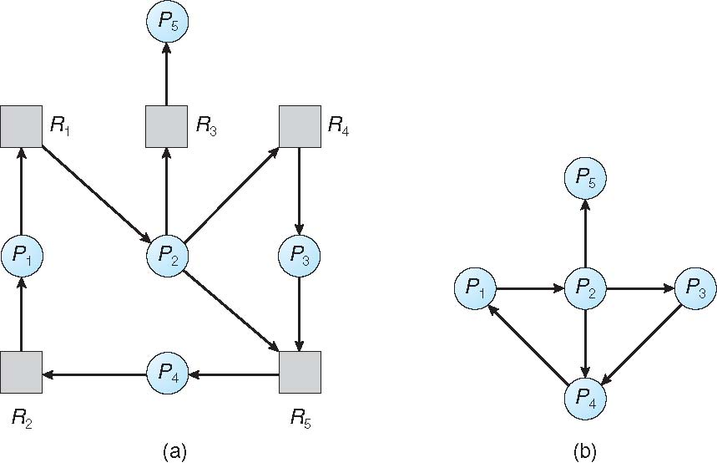
Resource-Allocation Graph and Wait-for Graph
Resource-Allocation Graph
Corresponding wait-for graph

Slide 40
Detection Algorithm
1. Let Work and Finish be vectors of length m and n, respectively Initialize:
(a) Work = Available
(b) For i = 1,2, …, n, if Allocation_{i} ≠ 0, then Finish[i] = false; otherwise, Finish[i] = true
2. Find an index i such that both:
(a) Finish[i] == false
(b) Request_{i} ≤ Work
If no such i exists, go to step 4

Slide 41
Detection Algorithm (Cont.)
3. Work = Work + Allocation_{i} Finish[i] = true go to step 2
4. If Finish[i] == false, for some i, 1 ≤ i ≤ n, then the system is in deadlock state. Moreover, if Finish[i] == false, then P_{i} is deadlocked

Slide 42
Example of Detection Algorithm
Five processes P₀ through P₄; three resource types A (7 instances), B (2 instances), and C (6 instances)
Snapshot at time T₀:
Allocation Request Available
A B C A B C A B C
P₀ 0 1 0 0 0 0 0 0 0
P₁ 2 0 0 2 0 2
P₂ 3 0 3 0 0 0
P₃ 2 1 1 1 0 0
P₄ 0 0 2 0 0 2
Sequence <P₀, P₂, P₃, P₁, P₄> will result in Finish[i] = true for all i

Slide 43
Example (Cont.)
P₂ requests an additional instance of type C
Request
A B C
P₀ 0 0 0
P₁ 2 0 2
P₂ 0 0 1
P₃ 1 0 0
P₄ 0 0 2
State of system?
Can reclaim resources held by process P₀, but insufficient resources to fulfill other processes; requests
Deadlock exists, consisting of processes P₁, P₂, P₃, and P₄

Slide 44
Recovery from Deadlock: Process Termination
Abort all deadlocked processes
Abort one process at a time until the deadlock cycle is eliminated
In which order should we choose to abort?
Priority of the process
How long process has computed, and how much longer to completion
Resources the process has used
Resources process needs to complete
How many processes will need to be terminated
Is process interactive or batch?

Slide 45
Recovery from Deadlock: Resource Preemption
Selecting a victim – minimize cost
Rollback – return to some safe state, restart process for that state
Starvation – same process may always be picked as victim, include number of rollback in cost factor

